Slide 1
INTRUSION DETECTION SYSTEM
Prepared by –
Bokhtiar Adil prottoy, Asif Mohammad Saad, Rakib
Department of computer science and engineering,
Khulna university of engineering and technology,
Khulna, Bangladesh

Slide 2
What is Intrusion Detection System or IDS?
An effective, less power and resource consuming and trustworthy automated device.
Inexpensive, safe and energy-efficient approach to developing a small, flexible and smart security system.
Can be used to ensure and strengthen security of bank vault, empty household or other restricted areas where only the authorized personals can enter.

Slide 3
Why should we use IDS?
As the world gets more digitalized and modern, private assets and properties require multilevel security with higher maintenance.
The IDS has the job to automate the whole security of private properties and prevent the entrance of unauthorized entities.
By mechanizing the security system, partially, the cost of maintenance would be reduced exponentially,
The level of security would be incremented considerably.
Additionally, the maintenance and set-up costs are not quite as high as other methods and techniques for automated security.
It welcomes any specialized upgrades that might need to be made as per the situation required. The proposed project tends to generalize the whole security mechanism, which can be extended or replaced with better or more suitable modules if required.

Slide 4
Principle of IDS
The basic principle of this project is fairly simple.
It uses a motion sensor to detect any unauthorized presence within the restricted area.
If intrusion detected, IDS notifies the authority concerned using an alarm to take further steps.
IDS also contains a pleasing user interface including a LCD display and a keypad.
It only allows the authorized personal enter the area if they can provide the correct authentication password.

Slide 5
Components of IDS
Arduino Mega 2560 R3
Passive Infrared Sensor
Active Buzzer
20x4 LCD Display
4x4 Keypad
Power Supply
10k ohm Potentiometer
Breadboard
Connecting Wires

Slide 6
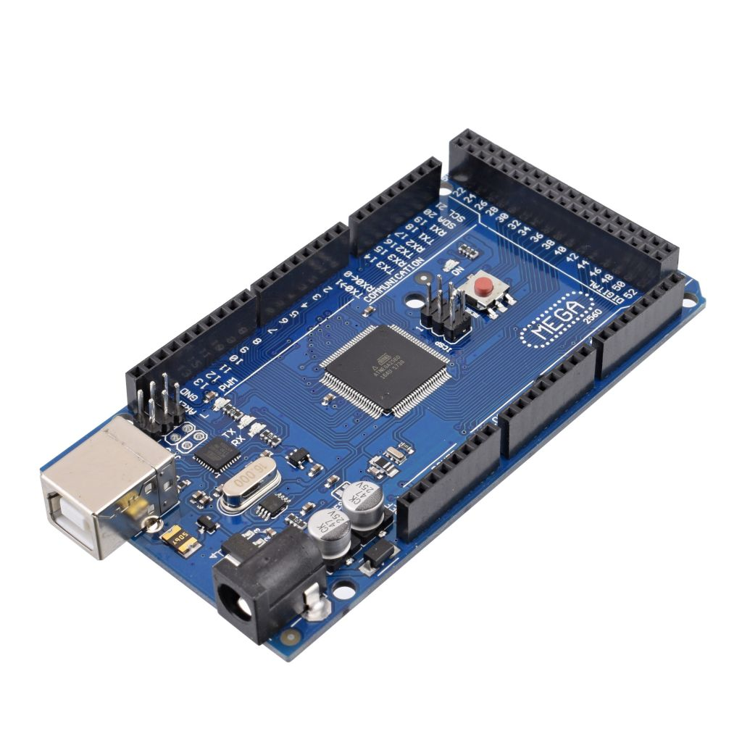
Components of IDS : Arduino Mega 2560 R3

Slide 7
Components of IDS : Arduino Mega 2560 R3
High performance
Low power consuming
8-bit Microcontroller
4kb of EEPROM
54 digital pins
15 digital pins support PWM
16 analog pins
4 serial ports

Slide 8
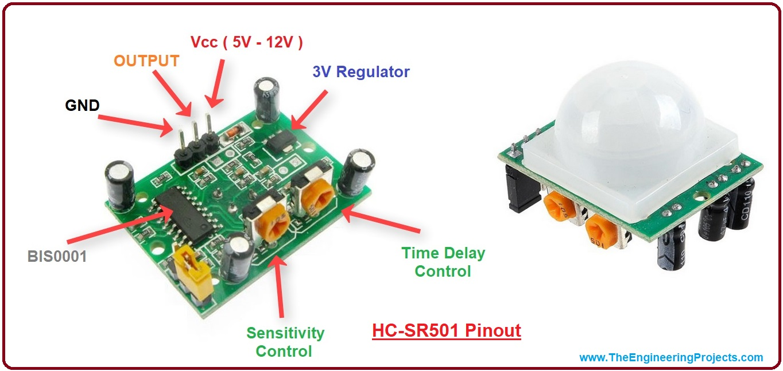
Components of IDS : PIR Sensor

Slide 9
Components of IDS : PIR Sensor
Consists of pyroelectric sensor and Fresnel lens
Detects motion by measuring change in the infrared levels emitted by the objects
Supply: 3.3V to 5V DC
Detection Range: 6 meters
Setting Time: 1 minute
Output: 5V TTL
Delay time adjustable
3 pins – VCC, Output and GND

Slide 10
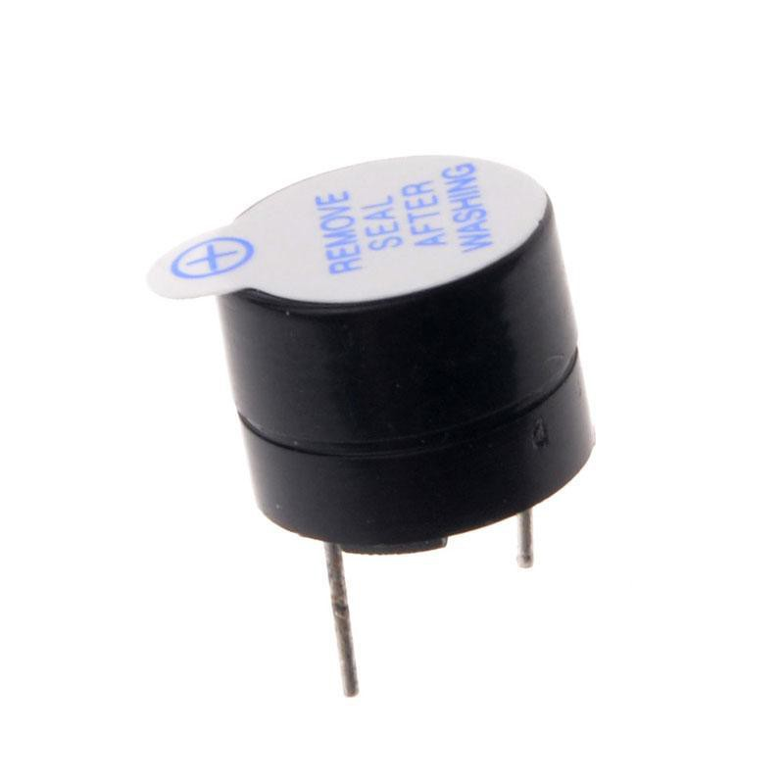
Components of IDS : Active Buzzer

Slide 11
Components of IDS : Active Buzzer
Piezoelectric type buzzer
Small size
Good frequency response
Less energy consumption
High sound pressure
Can generate different sounds like alarm, music, bell and siren.
2 pins – VCC, GND
Frequency Range: 3300Hz
Operating voltage range: 3V to 24V DC
Supply current below 15 mA

Slide 12
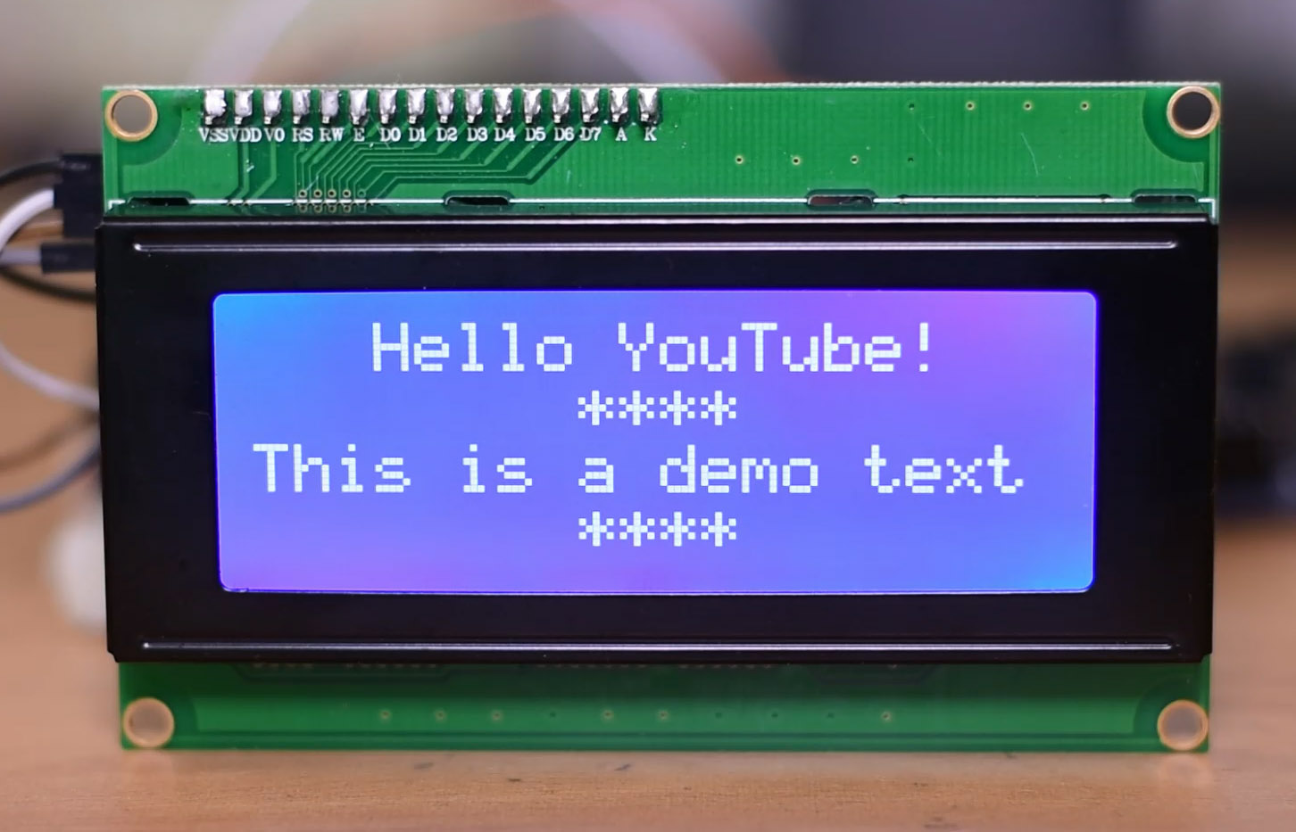
Components of IDS : LCD Display

Slide 13
Components of IDS : LCD Display
Liquid Crystal Display
20 characters wide, 4 rows
Supply voltage: 5V
16 pins, among them 8 data pins
Needs a potentiometer to control the display contrast
Uses LiquidCrystal library

Slide 14
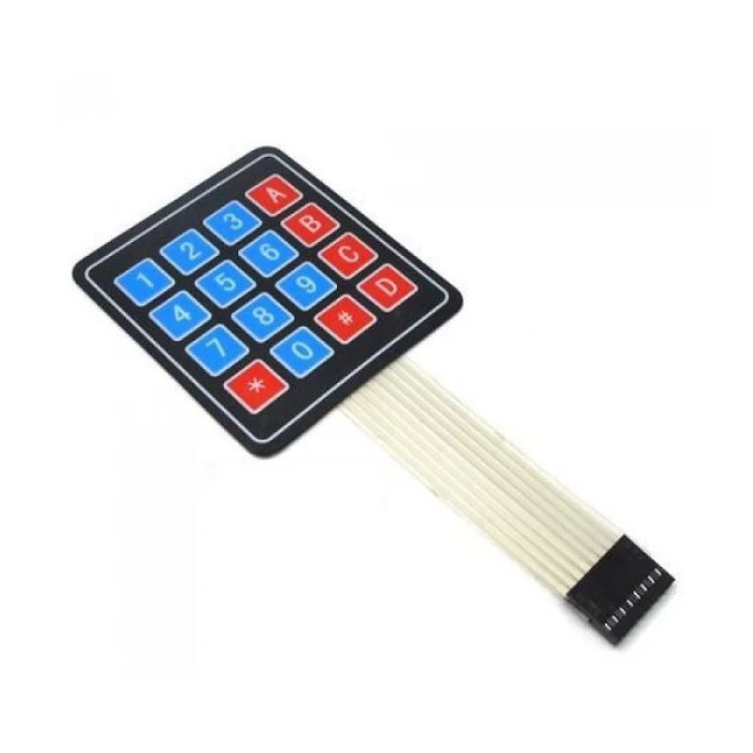
Components of IDS : Keypad

Slide 15
Components of IDS : Keypad
If button is not pressed, output terminal’s level is high
Otherwise, its level is low
Small in size, thin and light
Uses a matrix to track the keys
4 rows, 4 columns
8 pins (one for each row and column)

Slide 16
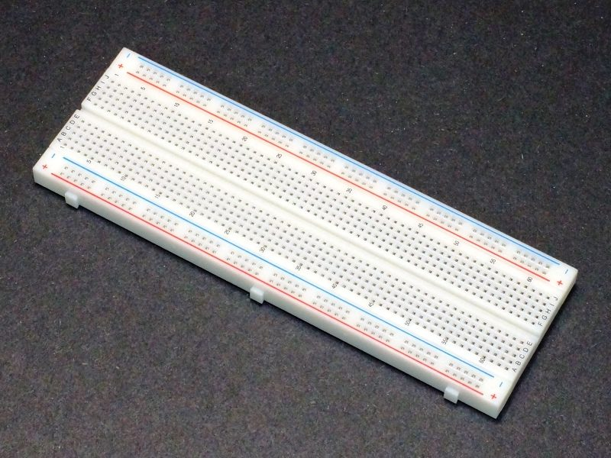
Components of IDS : Breadboard

Slide 17
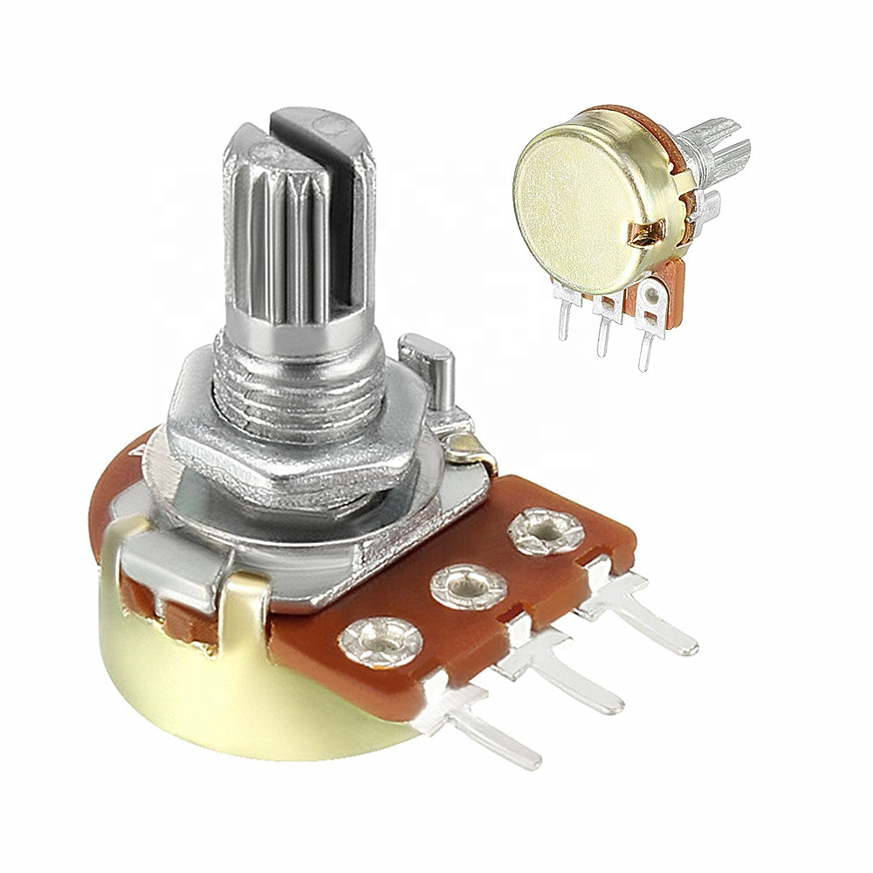
Components of IDS : Potentiometer

Slide 18
Components of IDS : Potentiometer
10k ohm
3 pins – VCC, Output and GND
Used for controlling LCD display contrast
Passive devices – does not need additional circuitry for it’s basic function
Variable resistor

Slide 19
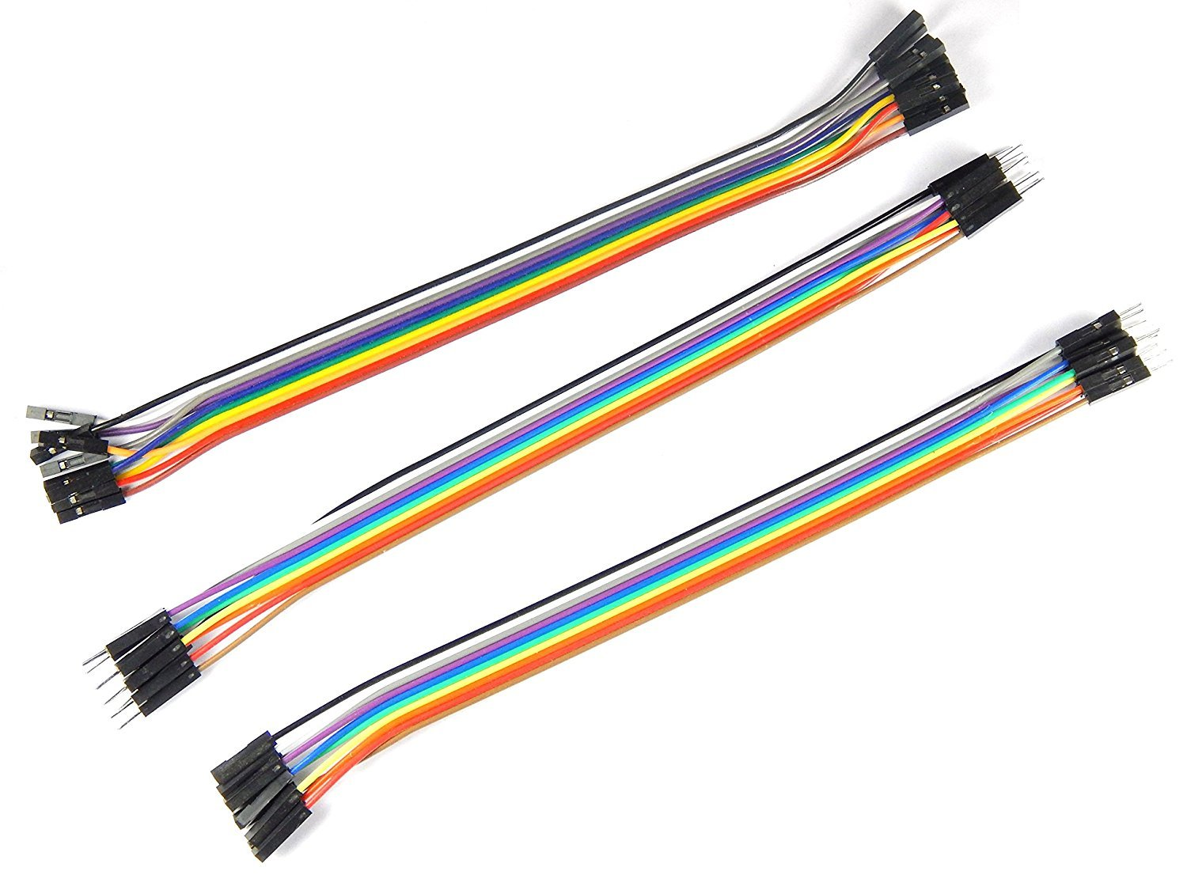
Components of IDS : Connecting Wires

Slide 20
Components of IDS : Connecting Wires
3 types
Male to Male
Male to Female
Female to Female

Slide 21
How does IDS functions?
Two PIR sensor aka Motion Sensor is established in 2 separate rooms which are connected to Arduino Mega R3. A LCD display and a keypad are also connected to arduino for suitable user interface.
At first the system will remain deactivated. The LCD display will show main menu which instructs the user to press A to activate system and press B to change password.
If the user wants to activate the system, he will need to press A. Then he will have to enter the correct password. If the password is wrong, the system will reject him and won’t activate.
If the user wants to change password, he will need to press B. The he will have to enter the old password to confirm. If he enters wrong password, system will reject him. Then he can update the password.

Slide 22
How does IDS functions?
If the authorized user activates the system, the system will show the activation status in LCD display. Once activated, upon detecting any movement in restricted rooms, the alarm will go off. Only an authorized person can stop the alarm using password.
After activation, if the authorized person wants to enter the area himself, he will need to insert password and deactivate the system. He can reactivate it after his work is done.

Slide 23
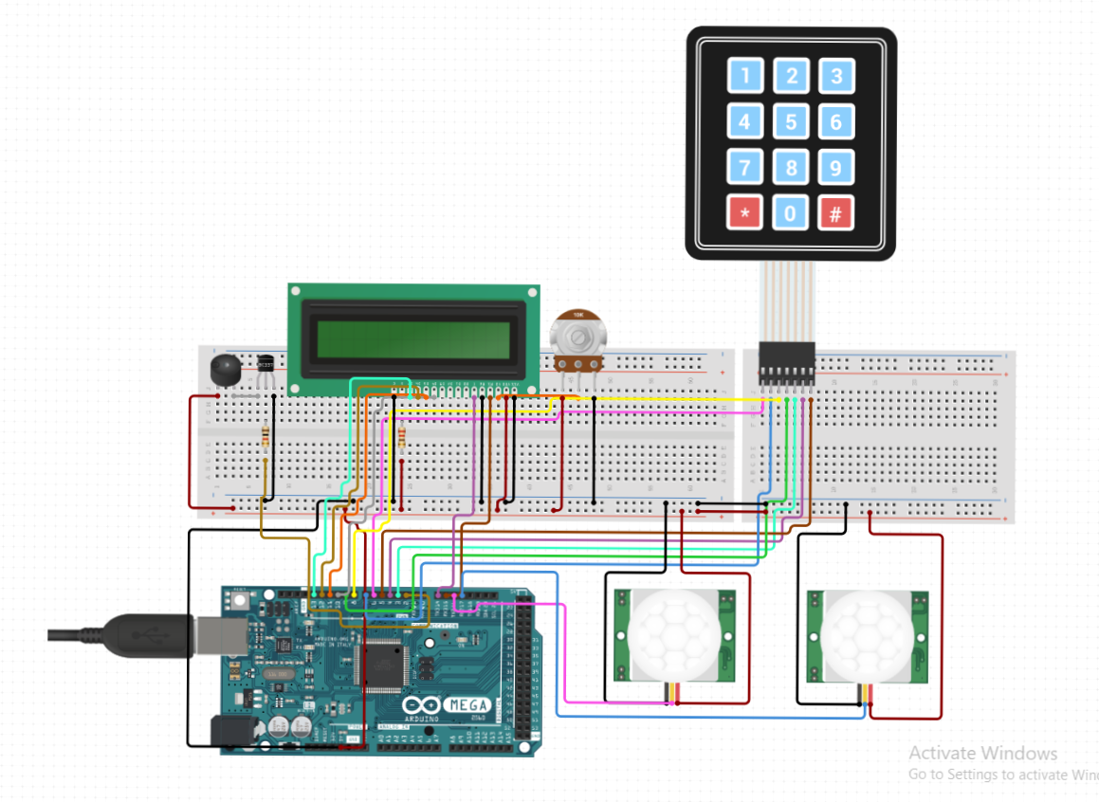
Circuit Diagram of IDS
Potentiometer
Keypad
LCD Display
Buzzer
PIR Sensor
Arduino Mega

Slide 24
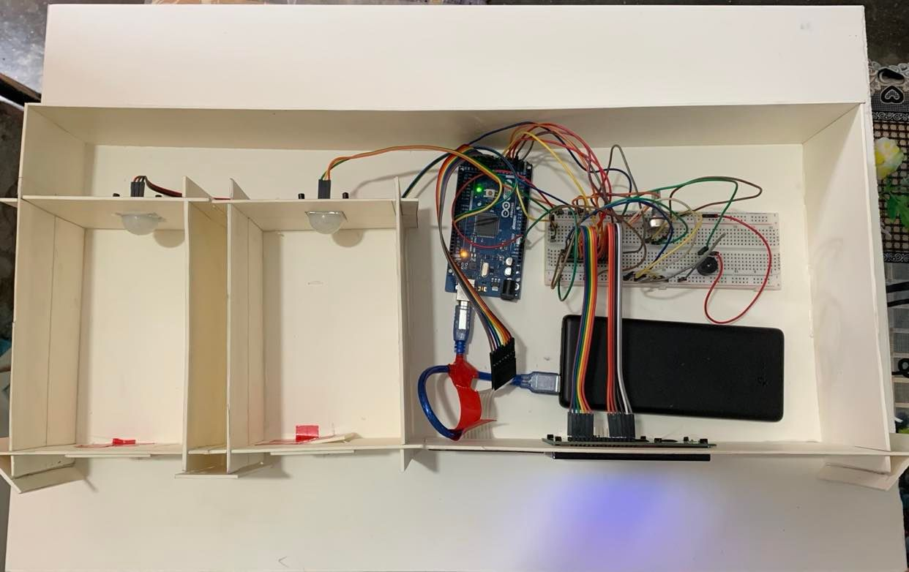
IDS Device in Project Structure (Top View)

Slide 25

IDS Device in Project Structure (Front View)

Slide 26
References
https://arduino.cc
www.google.com
www.youtube.com
https://create.arduino.cc/projecthub

Slide 27
Thank You

